Slide 1

Predicting LUNG DISEASE USING DEEP LEARNING
Odes Mullins
Regis University
MSDS 692 – Practicum I Project
Date: 03/08/2020

Slide 2
INTRODUCTION
Goal to predict Lung Disease
Use National Institute of Health (NIH) Dataset
Use Deep Learning for Predictions
Six Categories Predicted from X-rays
Jupyter Notebook in Google Colab Used

Slide 3
Data Collection and Cleaning
Extraction
NIH Clinical Center Website Source
Downloaded X-ray Images Zipped Files
Used 7-Zip to Unzip Files
Downloaded Companion csv File
Selected 6 Categories for Deep Learning

Slide 4
Data Collection and Cleaning
Data Setup
New csv File for 6 Categories
Extracted Images for 6 Categories
Removed Rows for Missing Images
Split Into Train, Validation, & Test
Loaded Data to Google Colab

Slide 5
Exploratory Data Analysis
Image Index & Finding Labels Needed
Some Columns Had Interesting Information
Image Size Columns Not Needed

Slide 6
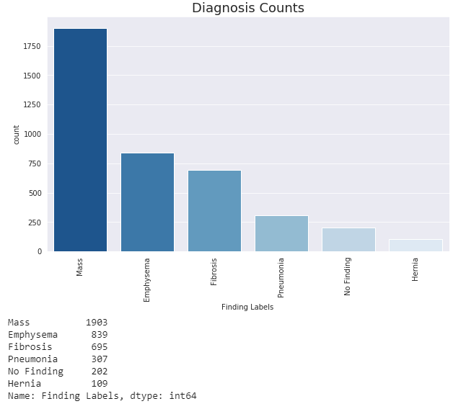
Exploratory Data Analysis
Diagnosis Counts

Slide 7
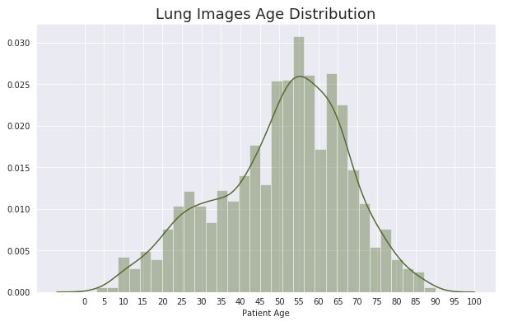
Exploratory Data Analysis
Age Distribution

Slide 8
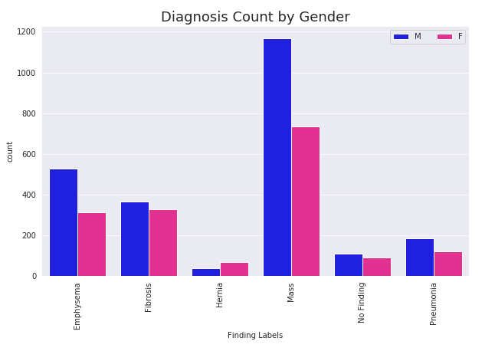
Exploratory Data Analysis
Diagnosis Count by Gender

Slide 9
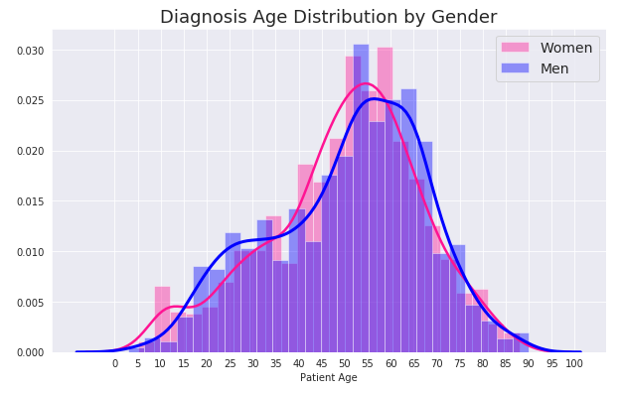
Exploratory Data Analysis
Diagnosis Age Distribution by Gender

Slide 10
Regression Models
Set Up and Execution
10 regression models with deep learning
Used set.seed(42) for repeatable results
Resized images to same size
Categorical used for 6 classifications
Models adjusted for best results

Slide 11
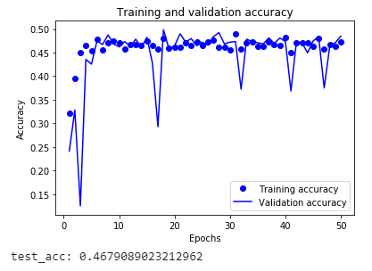
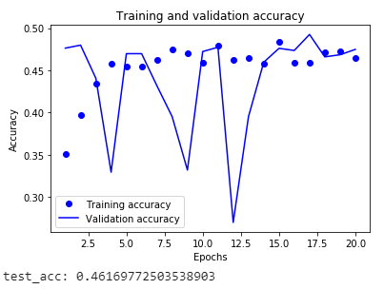
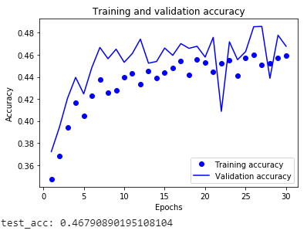
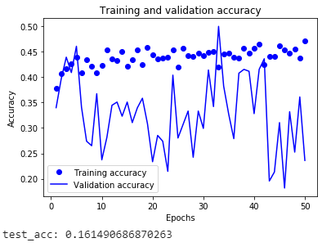
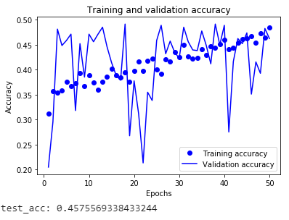
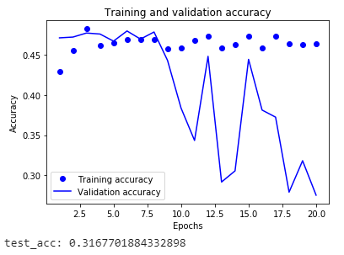
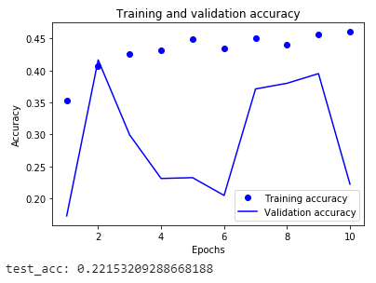
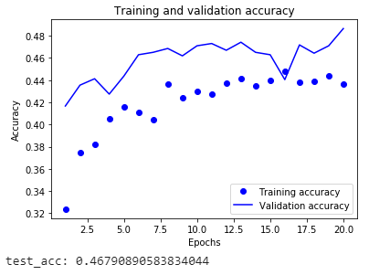
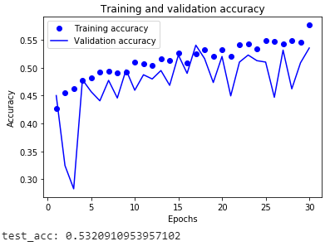
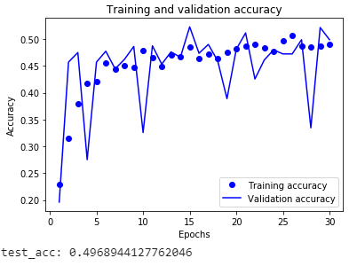
Regression Models
Training, Validation, & Testing Accuracy
Model 1 Model 2 Model 3 Model 4 Model 5
Model 6 Model 7 Model 8 Model 9 Model 10

Slide 12
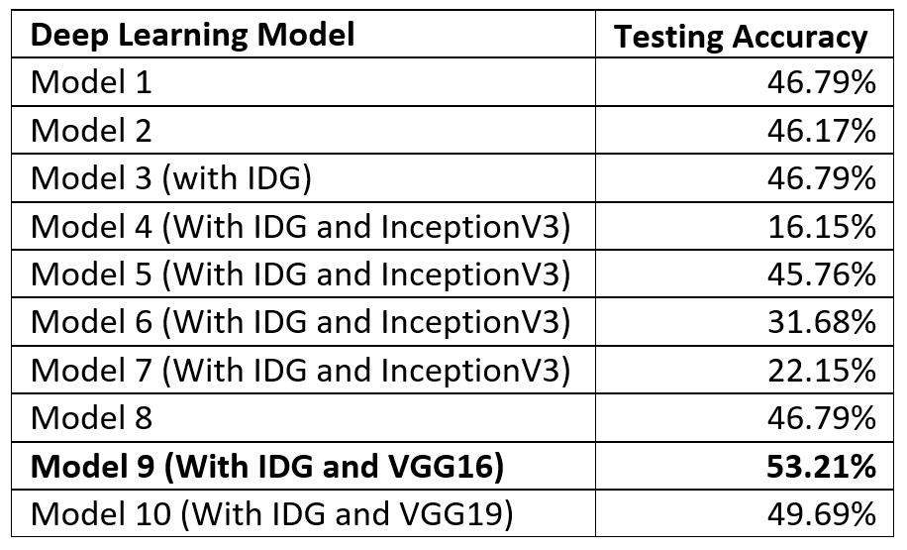
Regression Models
Deep Learning Models Evaluation

Slide 13
Possible Future Projects
Use two or three categories
Use categories with multiple classifications
Similar number of category images

Slide 14
Conclusion
Ran multiple Deep Learning Models
Only VGG16 above 50% accuracy
Utilized tools from prior classes
Category count differences maybe factor
Pre-trained networks are useful tools

Slide 15
References
https://nihcc.app.box.com/v/ChestXray-NIHCC
https://www.hackerearth.com/practice/machine-learning/challenges-winning-approach/deep-learning-challenge-two/tutorial/
https://stackoverflow.com/questions/46717742/split-data-directory-into-training-and-test-directory-with-sub-directory-structu
https://matplotlib.org/3.1.0/gallery/color/named_colors.html

